Slide 1
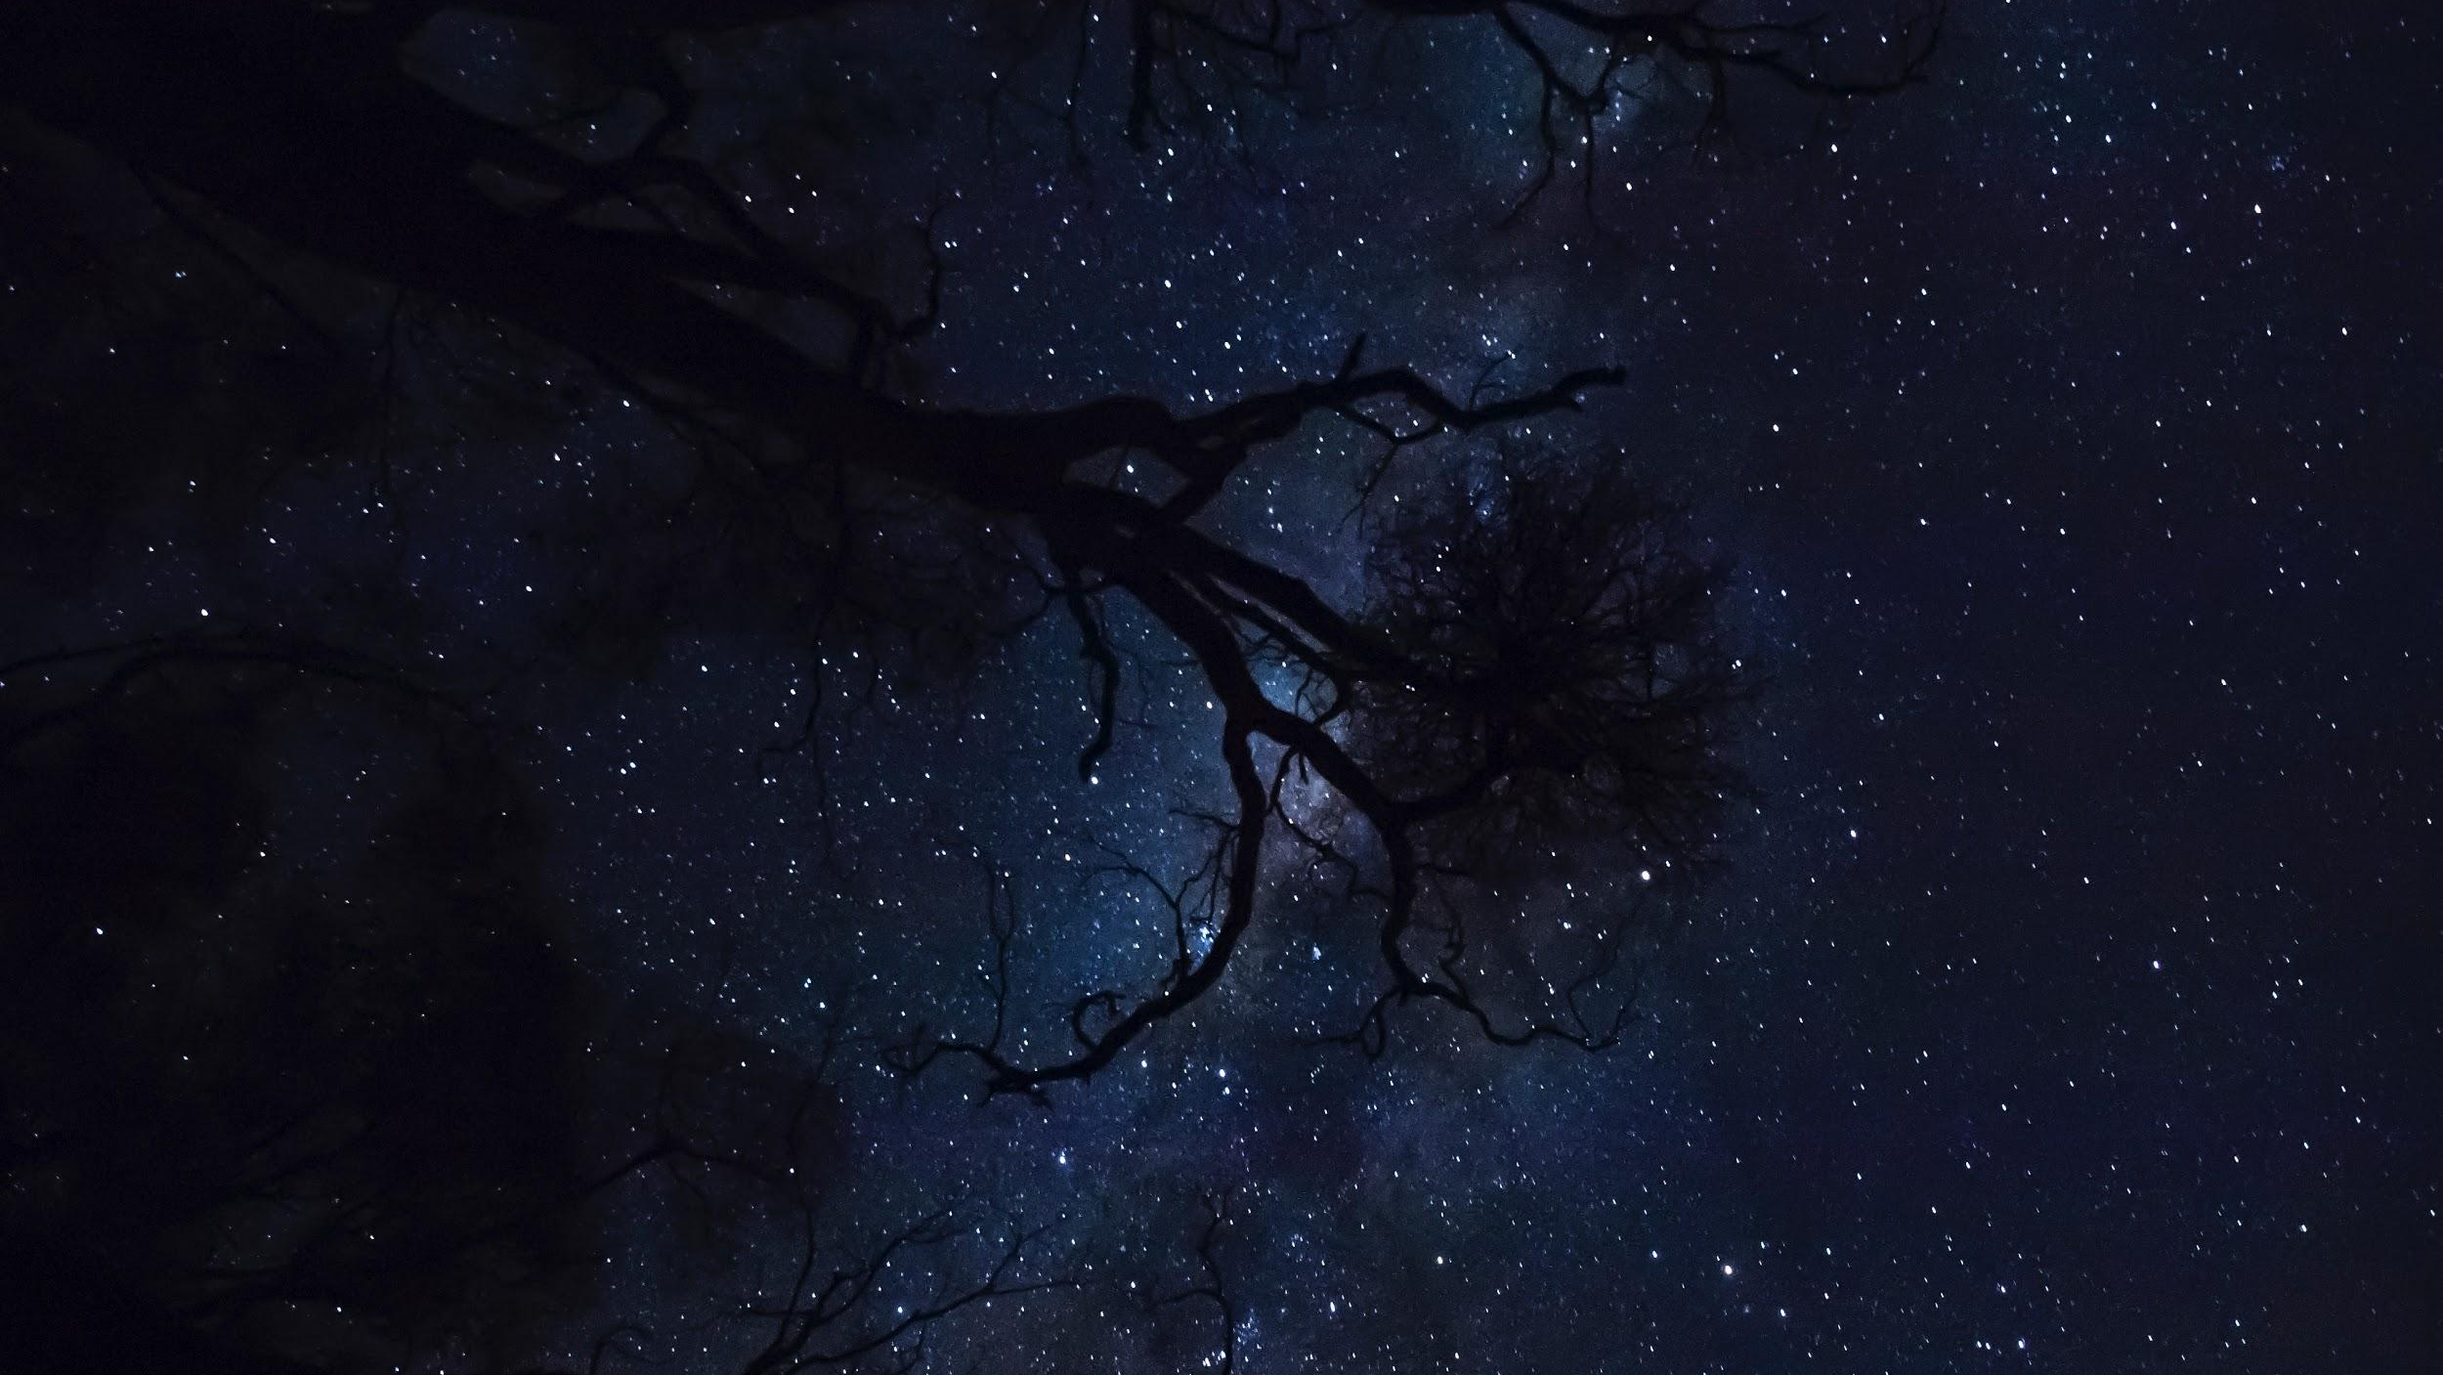
SOLAR SYSTEM MODELS
We will analyse different models of the solar system developed through history

Slide 2
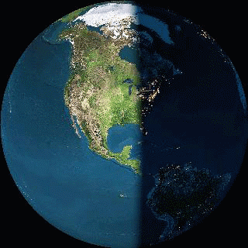
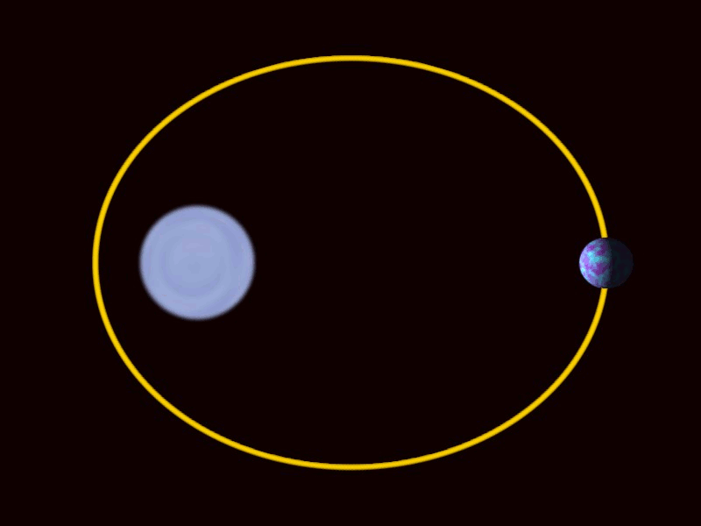
What’s the difference between rotation and orbit?
Write it on your whiteboard.

Slide 3
Repeat the opposite word/phrase.
GRAVITY
PULL TOWARDS OBJECT

Slide 4
Repeat the opposite word/phrase.
ORBIT
PATH AROUND AN OBJECT

Slide 5
Which of these objects rotates the slowest?
Object | Rotation time
Earth | 1 day (24 hours)
Moon | 27 days
Sun | 24.5 days

Slide 6
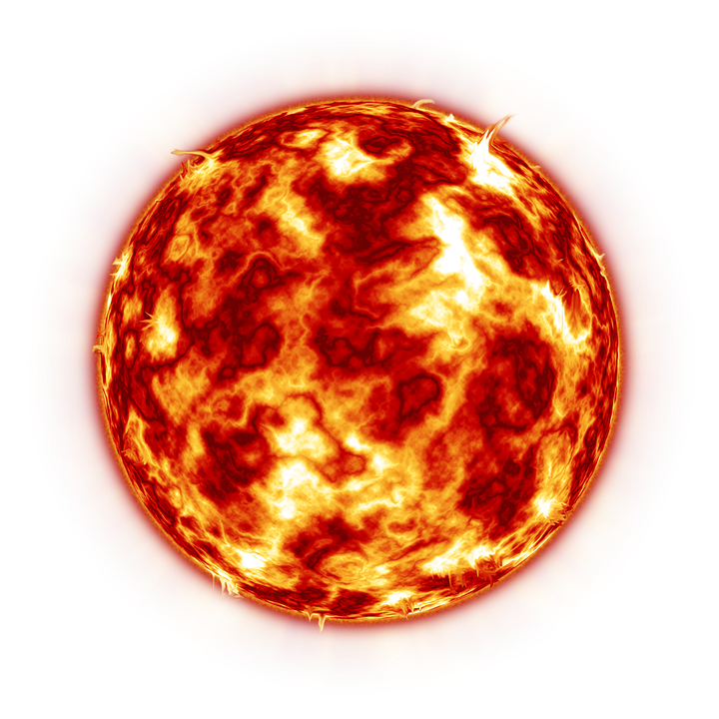
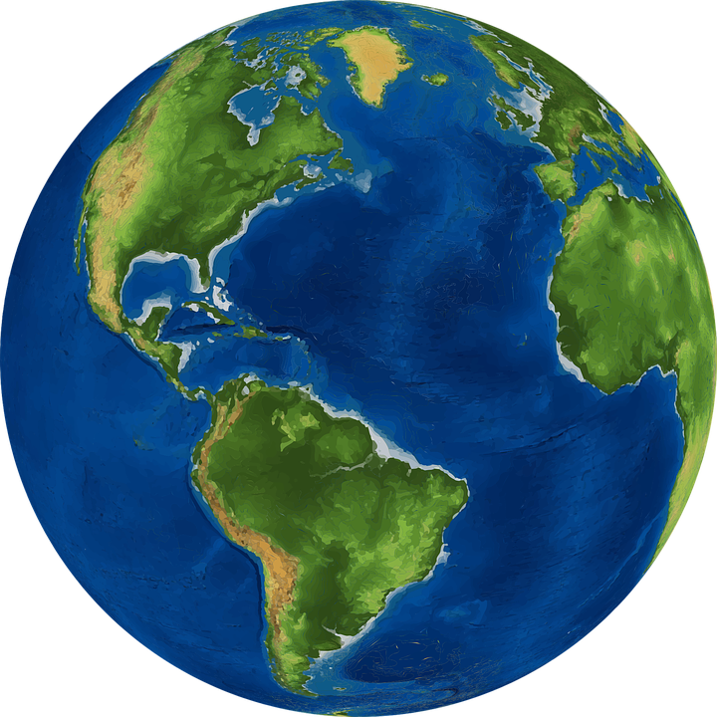
Draw a diagram of the Earth and Sun
Draw in the Earth’s axis
Show which side of the Earth would be day and night

Slide 7
We will analyse different models of the solar system developed through history
TRACK WITH ME
READ WITH ME
We will discuss models proposed by Copernicus, Khayyám and Galileo
DECLARE THE OBJECTIVE
Read the learning objective to your partner.
Notes:
Learning Objectives contain concepts (nouns, big ideas), skills (verbs, measurable behaviours) and sometimes context (restricting or targeting conditions).
●Example: Students will be able to describe the concept of density and apply it to floating and sinking.
●
Success criteria are specific measurable outcomes that if met mean that the student has met the learning objective.
Examples:
•Students will be able to compare densities of substances using mass and volume.
•Students will be able to identify whether a solid or liquid will float or sink in a liquid based on their densities.

Slide 8
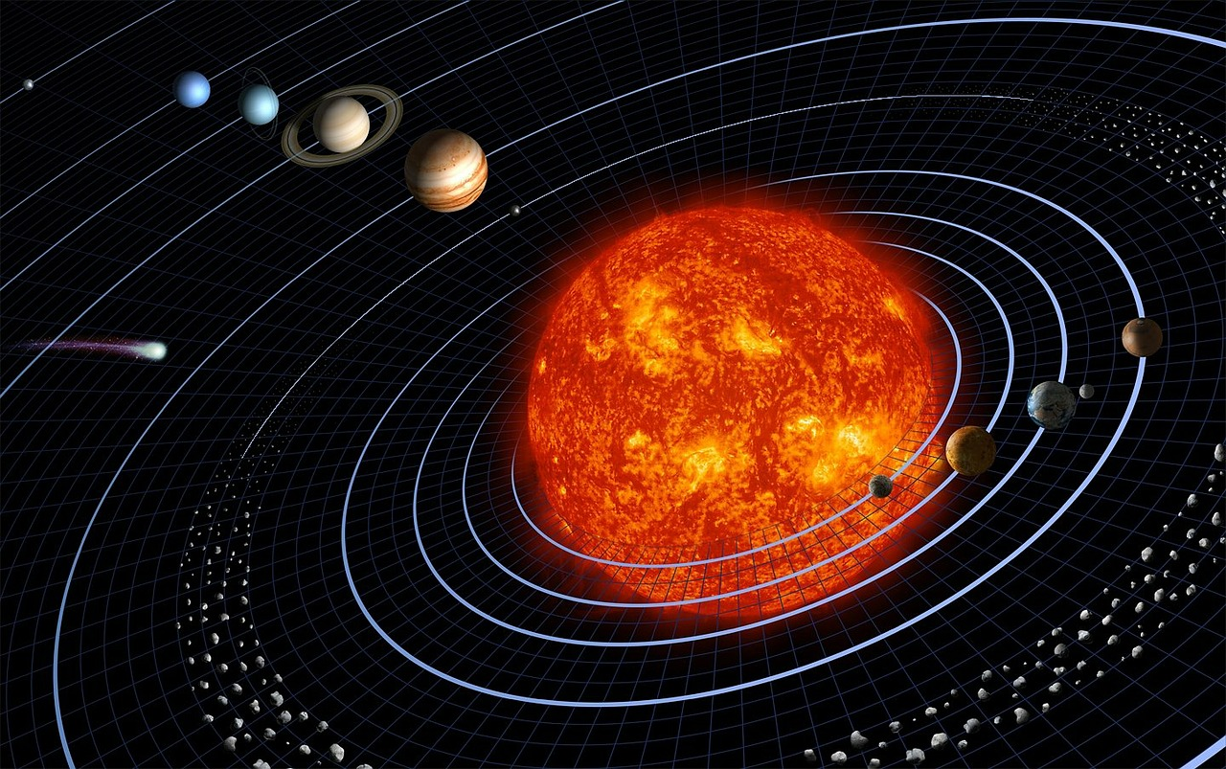
We will analyse different models of the solar system developed through history
Write down as many things you know about our solar system.
MAKE THE CONNECTION
Students, you already know that the sun, the moon and the Earth are part of the solar system. Additionally, objects in space travel in orbits.

Slide 9
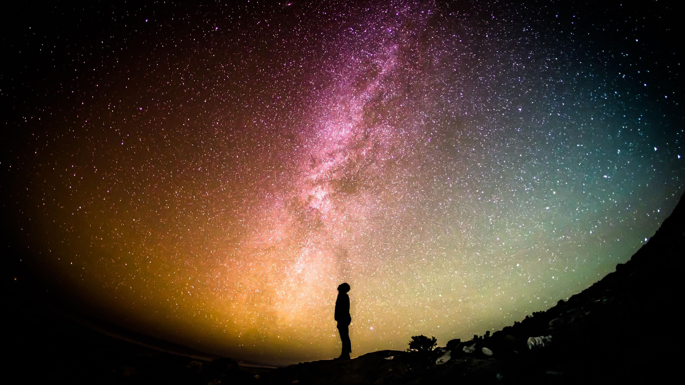
We will analyse different models of the solar system developed through history
Many models have been created to explain the orbits of the stars, planets and satellites in the solar system. Scientific models are used to make difficult ideas easier to understand.
Models of the Solar System can generally be classified as geocentric or heliocentric.
A geocentric model is created with the Earth at the centre of the Solar System.
A heliocentric model is created with the Sun at the centre of the Solar Systems.
CHECK FOR UNDERSTANDING
If a model has the Sun in the centre of the Solar System, is it: Geocentric Heliocentric Explain.

Slide 10
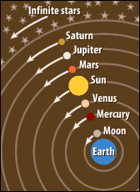
We will analyse different models of the solar system developed through history
Looking at the night sky, astronomers like Aristotle, Ptolemy and Khayyám could see the stars and planets moving around the Earth, creating the geocentric₁ model.
Khayyám’s model of the solar system believed that the Earth was the centre of the Universe.
The Earth was located in a fixed₂ position, with the planets, moons and stars orbiting the Earth.
CHECK FOR UNDERSTANDING
The geocentric model was created with the idea that the Earth was not moving. Why did early scientists and astronomers think this?
VOCABULARY
1 - Earth centred 2 - stationary, not moving
Notes:
http://scaleofuniverse.com/
https://amazing-space.stsci.edu/resources/explorations/groundup/lesson/basics/g37/ - Image taken from

Slide 11
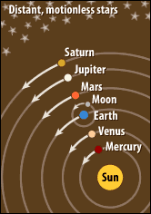
We will analyse different models of the solar system developed through history
As the centuries passed, astronomers began to question about the geocentric₁ model as it could not explain why certain planets moved back and forth. For this reason, the heliocentric₂ model was created.
Copernicus’ model of the solar system believed that the Sun was the centre of the Universe.
The Sun was located in a fixed position, with the planets and moons orbiting the sun.
MAKE THE CONNECTION
Students, you already know that we orbit the Sun, however the movement of the stars makes it hard to understand. That’s why we use Scientific Models.
VOCABULARY
1 - Earth centred 2 - Sun centred
Notes:
http://scaleofuniverse.com/
https://amazing-space.stsci.edu/resources/explorations/groundup/lesson/basics/g37/ - Image taken from

Slide 12
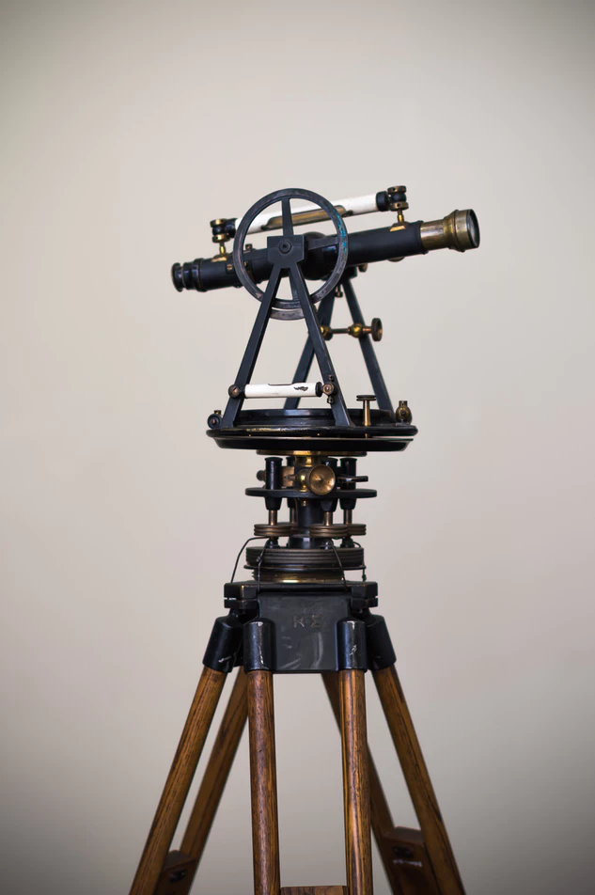
We will analyse different models of the solar system developed through history
In the 17th century, Galileo observed Jupiter’s moons orbiting the gas giant after inventing a more powerful telescope₁.
This created the idea that smaller objects such as the moon would orbit larger objects like the Earth.This would be used to support the heliocentric model.
CHECK FOR UNDERSTANDING
What made astronomers believe that Earth could be orbiting the Sun?
VOCABULARY
1 - device to make distant objects appear nearer
Notes:
http://scaleofuniverse.com/

Slide 13
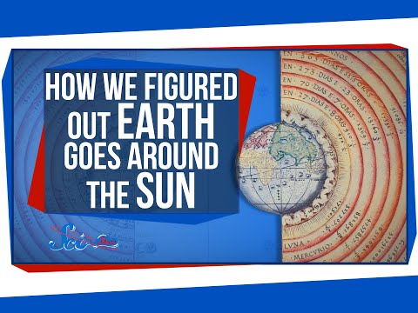
We will analyse different models of the solar system developed through history
CHECK FOR UNDERSTANDING
On your whiteboard write one new idea from the video about the solar system.
Notes:
SciShow video from - https://www.youtube.com/watch?v=khIzr6610cQ

Slide 14
We will analyse different models of the solar system developed through history
What is the difference between the geocentric and heliocentric models.
Compare Khayyám’s and Copernicus’ models by drawing them below.
CHECK FOR UNDERSTANDING
What did Galileo observe that helped prove the heliocentric model? Explain your answer.
Khayyám’s | Copernicus’
REMEMBER THE CONCEPT
Remember that the geocentric model argues that the Earth is the centre of the Solar System where the heliocentric model argues that the Sun is the centre of the Solar System.

Slide 15
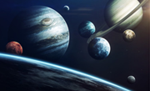
We will analyse different models of the solar system developed through history
To understand the relationships between Earth and our solar system, we need to understand why we use models in Science and how they develop over time.
CHECK FOR UNDERSTANDING
We use models in Science to make difficult ideas easier to understand. Why might we need models to explain the solar system?

Slide 16
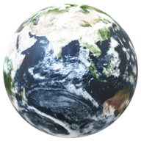
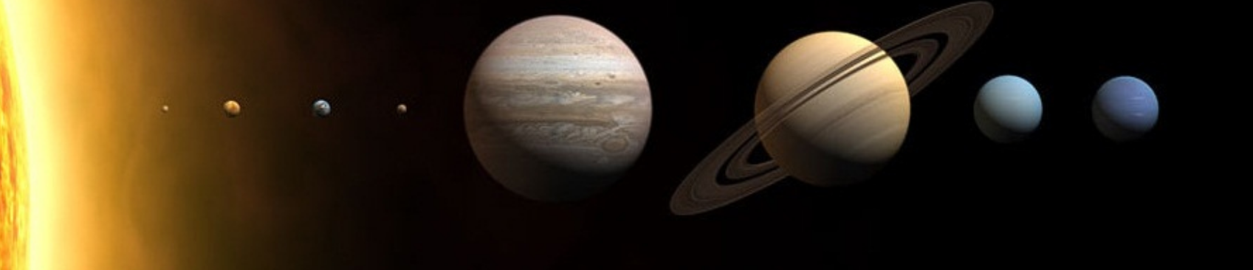
We will analyse different models of the solar system developed through history
We use models in Science to make difficult ideas easier to understand.
Khayyám’s geocentric model suggested that the Earth was the centre of the Solar System and everything orbited it.
Copernicus’s heliocentric model suggested that the Sun was the centre of the Solar System and was later supported by Galileo after he observed Jupiter’s moons orbiting the gas giant.
CHECK FOR UNDERSTANDING
What are the differences between the geocentric and heliocentric models?

Slide 17
We will analyse different models of the solar system developed through history
EXTENSION
On an A4 page, create a model of the Solar System to show how the planets orbit the sun. What type of model is this?
Why do we use scientific models to explain the Solar System?
How did Galileo’s observations of Jupiter’s moons support the heliocentric model?
Why did these models not include planets like Neptune and Uranus?
REMEMBER THE CONCEPT
Remember that our solar system contains the following: A sun 8 planets Dwarf planets Planets’ satellites
Notes:
Please include tasks/questions here rather than just referring to a worksheet. This will save on photocopying and facilitate sharing with other schools.
Try and build tasks/questions which escalate through Bloom’s Taxonomy. This will help with differentiation.

Slide 18
We will analyse different models of the solar system developed through history
We will discuss models proposed by Copernicus, Khayyám and Galileo
CHECK FOR UNDERSTANDING
Check Success Criteria.

